Slide 1

Florida Recycles Day 2023
Hillsborough County Solid Waste
Management Department
by
Randall Ceneus, M.A., PMP
Recycling & Waste Reduction Specialist

Slide 2
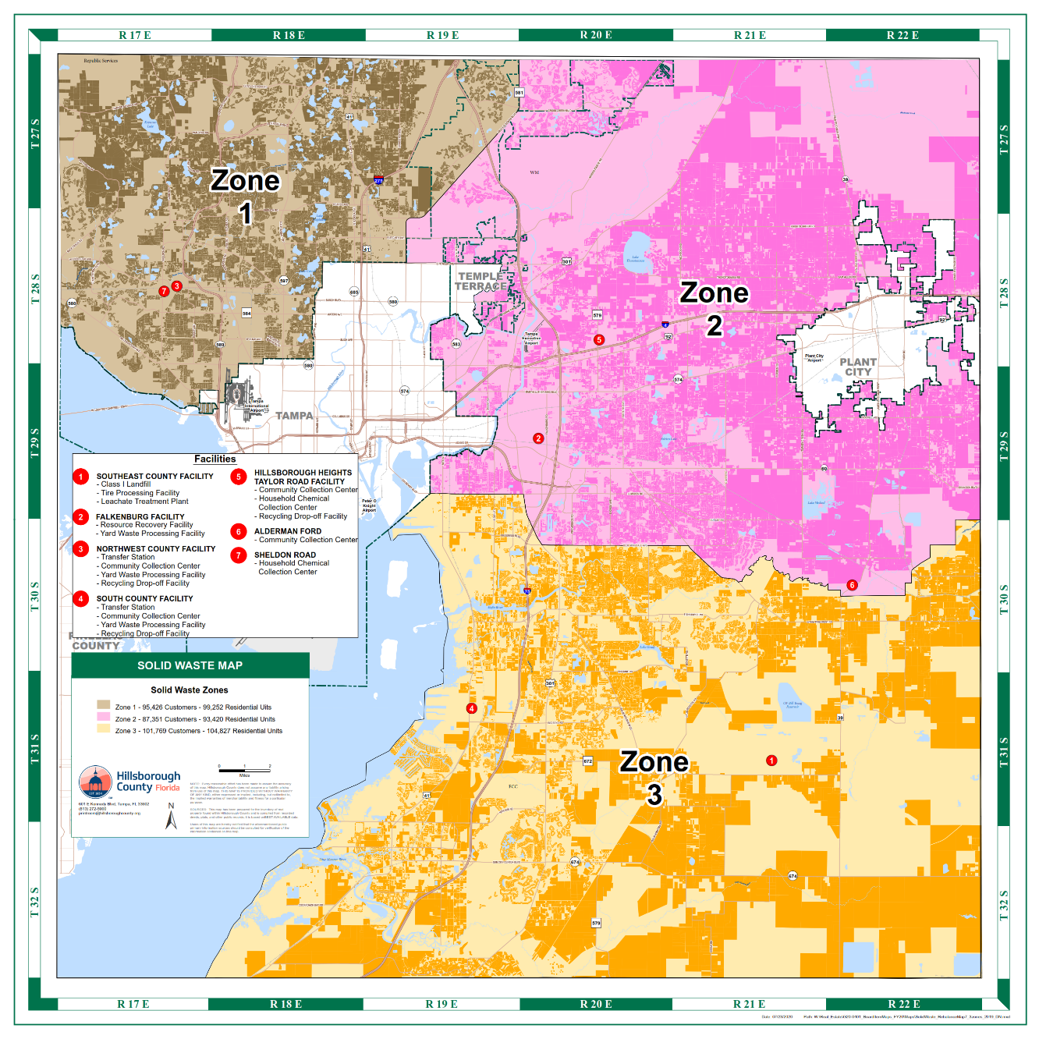
HILLSBOROUGH COUNTY OVERVIEW
Approximately 318,000 households serviced in unincorporated areas of the County
2-1-1 curbside collection performed by 3 contracted waste haulers
1 Landfill, 1 Waste-to-Energy Facility, 2 Transfer Stations, 5 Community Collection Centers, 2 Yard Waste Processing Sites, & 3 HHW Collection Events Monthly
Notes:
Hybrid work schedule
Backdoor disability, hardship credit, senior discount
The Solid Waste Management Department supports the County's donation programs such as the Cereal for Summer food donation drive, the cellphones for deployed soldiers, and Duffles of Dignity to provide care items for children in need.
3rd largest county in Florida
400 new accounts monthly on average

Slide 3
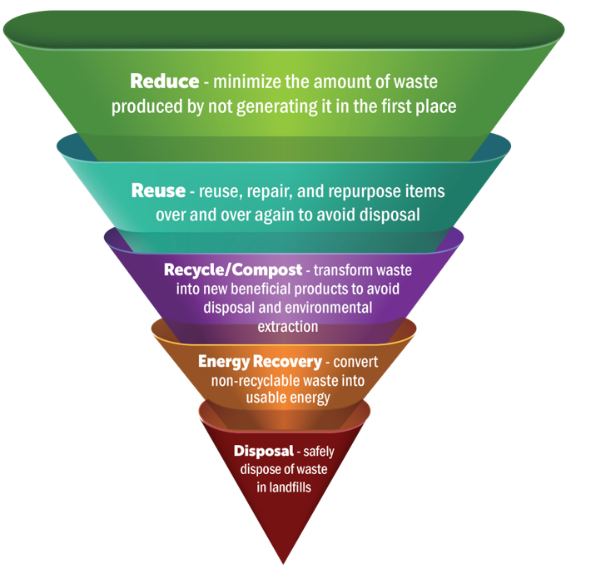

WASTE MANAGEMENT HIERARCHY
BOCC Adopted New Comprehensive Plan Solid Waste Section January 2022 pg.178-183
Obj. 1.1 - Adopt an integrated hierarchy of solid waste management using source reduction as the primary approach, followed in order by reuse, recycling/composting and energy recovery. Landfill disposal shall be considered the last resort.
https://planhillsborough.org/wp-content/uploads/2023/01/Hillsborough-County-Comprehensive-Plan.pdf
Notes:
Policy win for SW

Slide 4
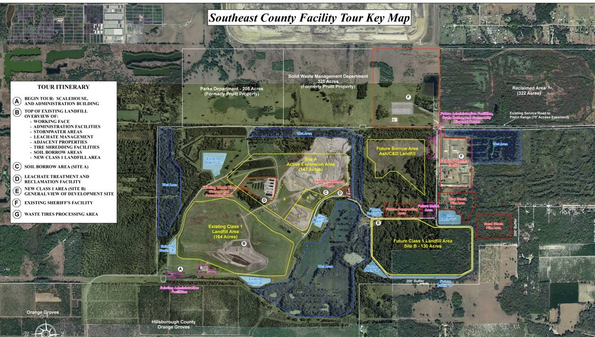

SOUTHEAST COUNTY LANDFILL
Alternative Daily Cover – FDEP Recycling Credit
  Mulched Yard Waste
  Waste-to-Energy Ash
Leachate Evaporator
  Uses landfill gas for power
  Evaporates 50,000 gallons/day
  Reduced total treatment costs by over 20%
  Reduced truckloads from 13 trips/day to 5 trips/day
15960 Co Rd 672, Lithia, FL 33547
Disposal/Landfill

Slide 5
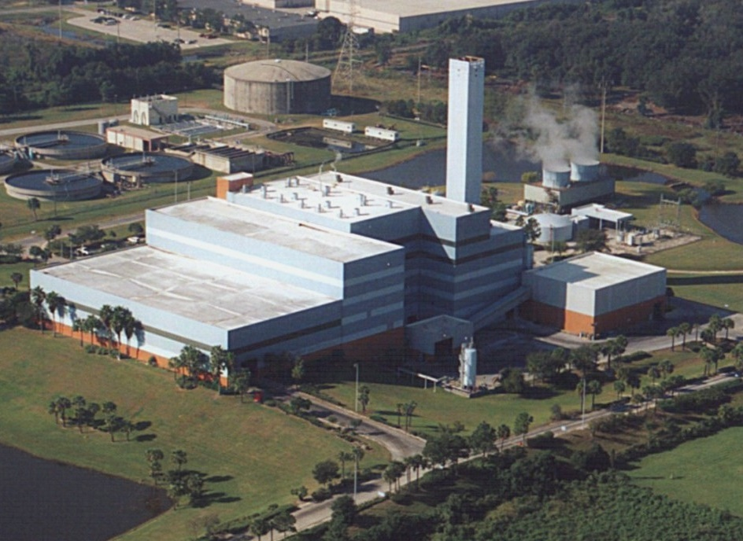
RESOURCE RECOVERY FACILITY
Produces 47 megawatts of renewable energy 24/7 - enough to power 23,000 homes a year
Includes self-serving energy campus powering other County facilities
Reduces waste volume by 80%-90%
Recovers 19,600 tons of metal for recycling annually - enough to build 15,000 cars
Reduced greenhouse gas emissions compared to landfilling
350 N Falkenburg Rd, Tampa, FL 33619
Began operation in 1987: 1,200 tons/day
Added fourth boiler in 2009: increased capacity to 1,800 tons/day
Energy Recovery
Notes:
second waste to energy plant in the U.S. to produce carbon offset credits for the voluntary market
County facilities powered by RRF:
Waste Water Treatment Plant
Faulkenburg County Jail
Powers the RRF
Trademark Metals Recycling

Slide 6
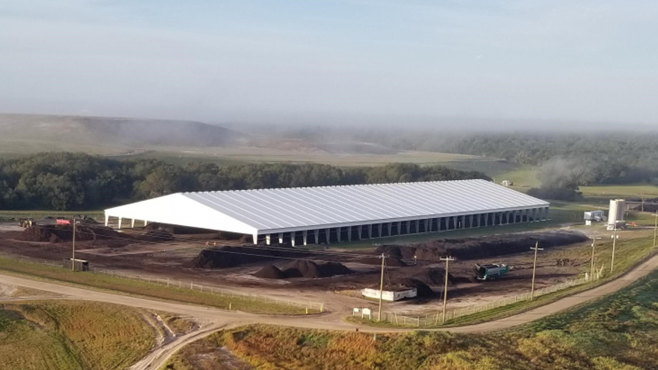
BIOSOLIDS-YARD WASTE COMPOSTING OPERATON
Composts 37,200 tons of biosolids annually
Composts 40,000 tons of yard waste annually
Produces 35,000 tons of compost annually
Saves ~$900,000/yr in hauling and disposal costs
Generates ~$200,000/yr in revenue from sale of compost
Retains moisture
Provides nutrients
15960 Co Rd 672, Lithia, FL 33547
Composting Operation -
Created new permanent jobs
Award winning (video)
Saves landfill space and reduces emissions
pH balance
Reduces fertilizer use
Recycling
Notes:
MSAP composting- Modified Static Aerobic Pile
AA grade Compost
36% reduction in transportation and disposal costs

Slide 7
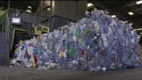
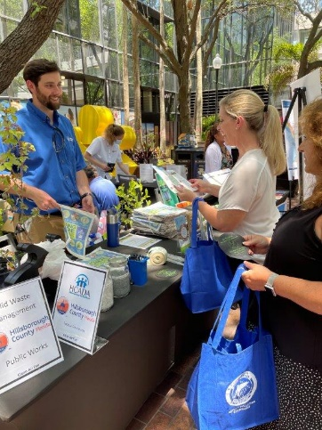

CURBSIDE RECYCLING PROGRAM
Collection for single-stream curbside recycling began October 2013
Collects 62,000 tons per year; 67% cart setout rate
Accepts plastic bottles, jugs, & containers; metal cans; glass bottles & jars; & paper, paperboard, & cardboard
Increased landfill lifespan by <2 years since Oct. 2013
Education & Outreach:
Fiscal Year | Presentations | Media Deliverables | Literature Distribution
FY2021 | 51 | 125 | 30
FY2022 | 70 | 153 | 91
FY2023 | 79 | 195 | 69
Recycling -
Saves resources, water, and energy
Creates jobs, wages, and tax revenue
Reduces greenhouse gas emissions
Recycling

Slide 8
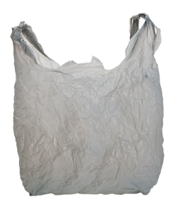
DO NOT BAG YOUR RECYCLABLES!

Slide 9
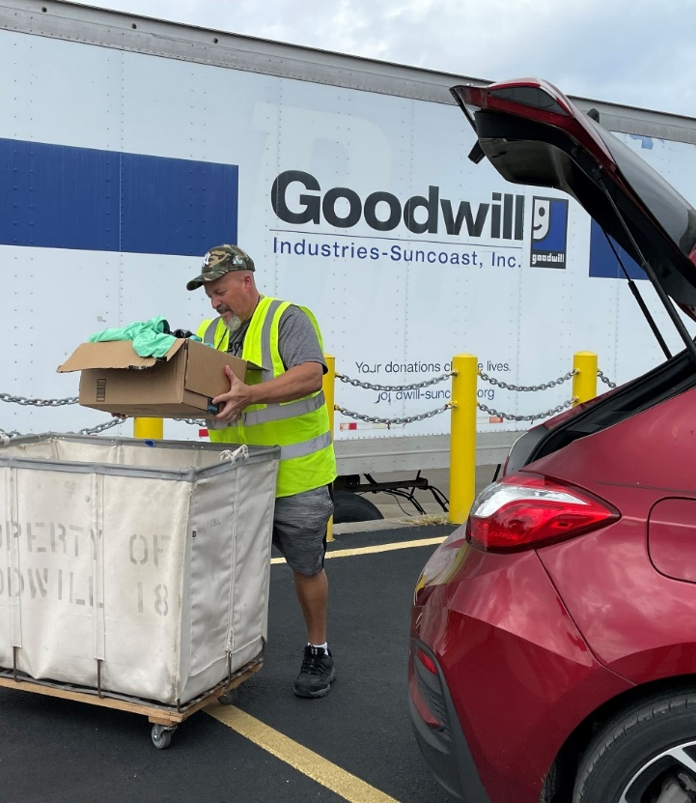
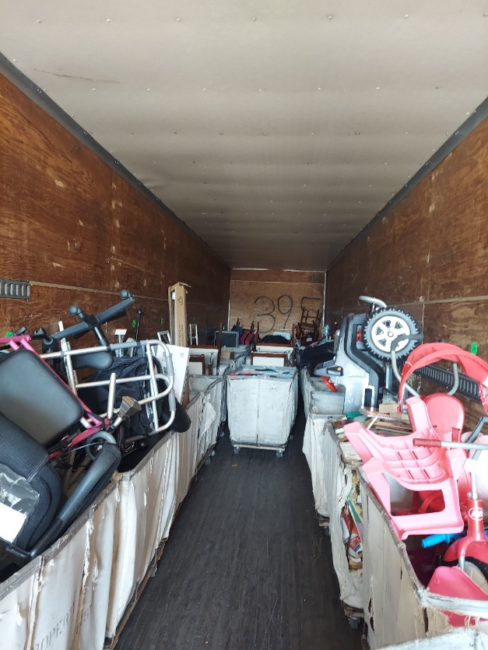
DONATION & WASTE DIVERSION PROGRAM
Partnership with Goodwill Industries-Suncoast to receive donations at Solid Waste Department disposal sites
Launched Pilot September 12th, 2022, and expanded to second site August 11th, 2023
Results through September 1st, 2023:
Award-Winning Program
  Recycle Florida Today Outstanding Public Program 2023
  Plan Hillsborough Planning & Design Award 2023
Media Coverage
  5 Magazines
  4 TV News pieces
  3 Industry Newsletters
  2 Statewide Conference Presentations
 | Donor Count | Approximate Piece Count | Diverted Weight (lbs.)
TOTAL | 1,549 | 44,629 | 74,120
6209 County Road 579, Seffner, FL 33584
13000 U.S. Highway 41, Gibsonton, FL 33534
Goodwill Industries-Suncoast -
Decreased contamination & disposal
Creates 6 new jobs
12% increase in donations in area
Reuse

Slide 10




TAMPA BAY REGIONAL RECYCLING PARTNERSHIP
Award-winning awareness campaigns launched in March 2019 to encourage waste reduction and educate about recycling
Key feature of Reduce Your Use Tampa Bay Campaign:
  Individual Pledge for Residents: +2,200 pledges
  Business Pledge: 35 business partners
Received the Environmental & Participation Award of Excellence from Plan Hillsborough’s 40th Planning & Design Awards
ReduceYourUseTampaBay.org
TampaBayRecycles.org
Reduce
Notes:
Provide reusable promo items
Manage/Support KTBB

Slide 11


QUESTIONS?
Solid Waste
Recycling Coordinator
(p) 813-221-6549
(e) Recycling@HCFLGov.net
HCFLGov.net/Recycling
Notes:
Send PPT
Pictures
Videos
Pic of sustainable promo items

